Slide 1

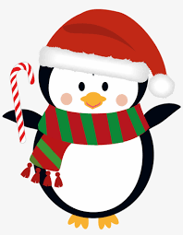
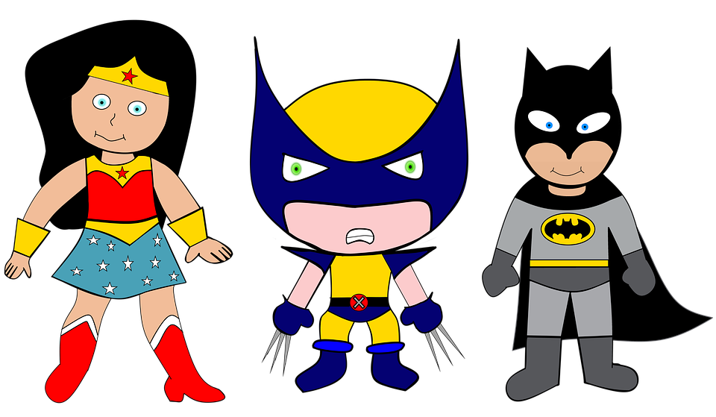

We are SUPERheroes!
Students Using their Powers to Engage in Reading!
Kindergarten Newsletter – December 6-10, 2021
IMPORTANT EVENTS
Breakfast ends at 7:25!
 | Star test week
The EXPERT in anything was once a BEGINNER!
HOMEWORK
Mon. – Thurs. | Weekly ELA Sheet Math HW Pages Practice Sight Words List Read 10 minutes per night
WEEKLY ASSESSMENTS
ELA | Module 4.3 test Spelling Test (ram, dab, fat, fan) Study Letter sounds
Math | Lesson 16 and 17 test Counting on from a given number to 20
SCHOOL NEWS
Be on the look out for information from your child's teacher about their Christmas party. December 21 is a 60% day. Winter Break is: December 22- January 7
WEEKLY MATH SKILLS
2D shapes/Positional words Writing 1,2,3,4,5,6,7,8,9,10 More and Less Decompose numbers 3-10 Adding/subtracting
REMINDERS
Please make sure all money is sent in your child’s blue folder labeled and sealed. If your child is absent, please send an excuse labeled with the following information: Child’s name, date of absence, teacher’s name, and reason for absence.
SCHOOL SAFETY
Be sure your child wears a mask to school DAILY!

Slide 2
Module 4 Week 3: Happy Healthy Me!
LEARNING MINDSET: Setting Goals
ESSENTIAL QUESTION
How can I be my healthiest self?
PHONICS
Introduce Letters: Ll and Hh - ot word family
READING
Genre: Fiction Story Elements: Characters, Settings, Events Informational Texts | Listening Comprehension Parts of a Book Collaborative discussions
WORDS TO KNOW
Are Lot Not Was
VOCABULARY
BIG IDEA WORDS: energy, exercise, healthy POWER WORDS: half, serving, varitety Books: Jack and the Hungry Giant and Edible Colors
REVIEW
Letters and sounds Aa-Ff Gg-Pp Qq-Zz
WRITING
Nouns and Verbs Characters/Setting Narratives
SPELLING WORDS
Ram Dab Fat Fan
PHONEMIC AWARENESS
Identify Rhymes Identify Syllables Beg., Medial, Final Sounds

